Slide 1
CS 4530: Fundamentals of Software Engineering Module 1.1 Course Introduction
Adeel Bhutta, Rob Simmons, and Mitch Wand
Khoury College of Computer Sciences
© 2026 Released under the CC BY-SA license

Slide 2
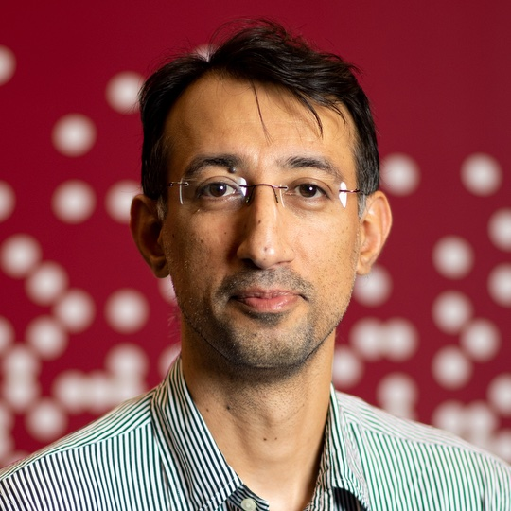
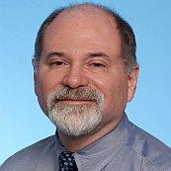
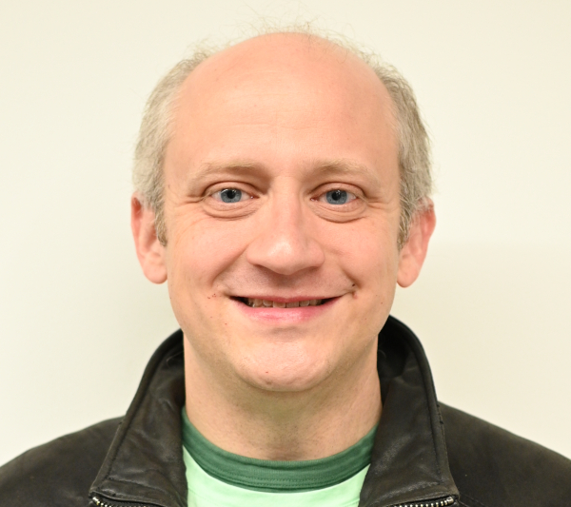
Instructors
Adeel Bhutta
Section 1,2,3
Mitch Wand
Section 4
Rob Simmons
Section 5,6

Slide 3
Teaching Assistants
We have around 360 students and 18 teaching assistants.
Their contact info and pictures are on the website https://neu-se.github.io/CS4530-Spring-2026/staff/

Slide 4
Learning Objectives for this Lesson
By the end of this lesson, you should be able to:
Explain in general terms what software engineering is
List your weekly obligations as a student
List the requirements for completing the course

Slide 5
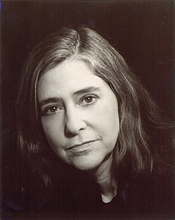
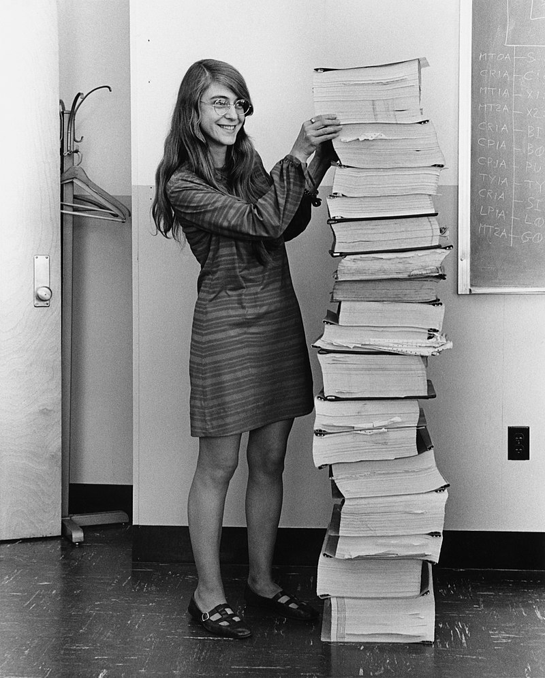


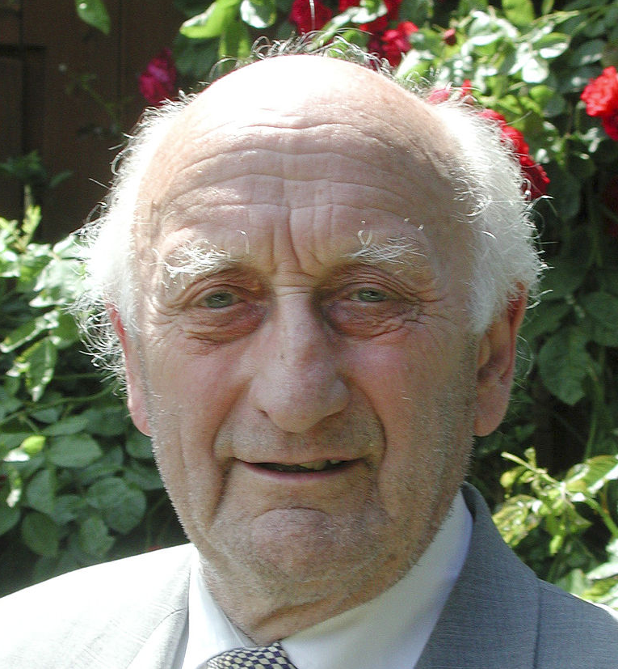
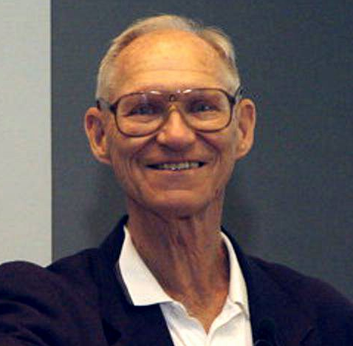

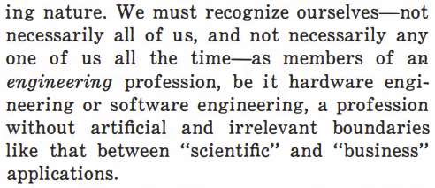
Origins of "software engineering"
Margaret Hamilton
@ NASA, around 1963
1968 NATO conference on Software Engineering + Outcomes​
The Apollo Guidance Computer's software, basically
Friedrich Bauer
Barry Boehm
Anthony Oettinger, ACM President
Comm. of the ACM,
August 1966 (page 546)
(all pictures from Wikipedia)
Notes:
Planning software projects is hard! The three generally accepted plausible origins of the term “software engineering,” and it seems likely multiple people generated the idea around the same time. These three origins tend to map pretty well onto the answers to “who do you think needed to invent software engineering”
The most commonly cited reference was Margret Hamilton, who by most accounts coined the term first in the process of needing to legitimize software as an engineering practice within NASA to get humanity to the moon
Ottinger came at the problem from looking at emerging trends in the business world from an academic perspective.
Bauer came at the problem from perspective of military organization, and organized 1969 NATO conference, where representatives from member countries described the current “software crisis - that software was often inefficient, low quality, hard to maintain, and sometimes never delivered.
The call to action from this report was to discover methods to build software that were as predictable in quality, cost, and time as, for instance, those used to build bridges in civil engineering. Barry Boehm often given credit to for promoting these ideas after the conference.

Slide 6
Goal: to make software an engineering discipline
Software engineering concerns the
design
construction,
and maintenance
of large programs
over time.
Notes:
Can we discover methods to build software that are as predictable in quality, cost, and time as, for instance, those used to build bridges in civil engineering?

Slide 7


Okay, what do you mean by "large"
The Apollo Guidance Computer's software
Almost any pre-series-B startup
Your 4-person project in this class
(image from “The Scale of Space” on KWIT, March 2018)
Notes:
Wildly different notions of scale at work, and from NATO to Google, the practice of software engineering is usually defined by the biggest players!
That doesn’t mean that there aren’t problems that everyone faces (at all scales).

Slide 8
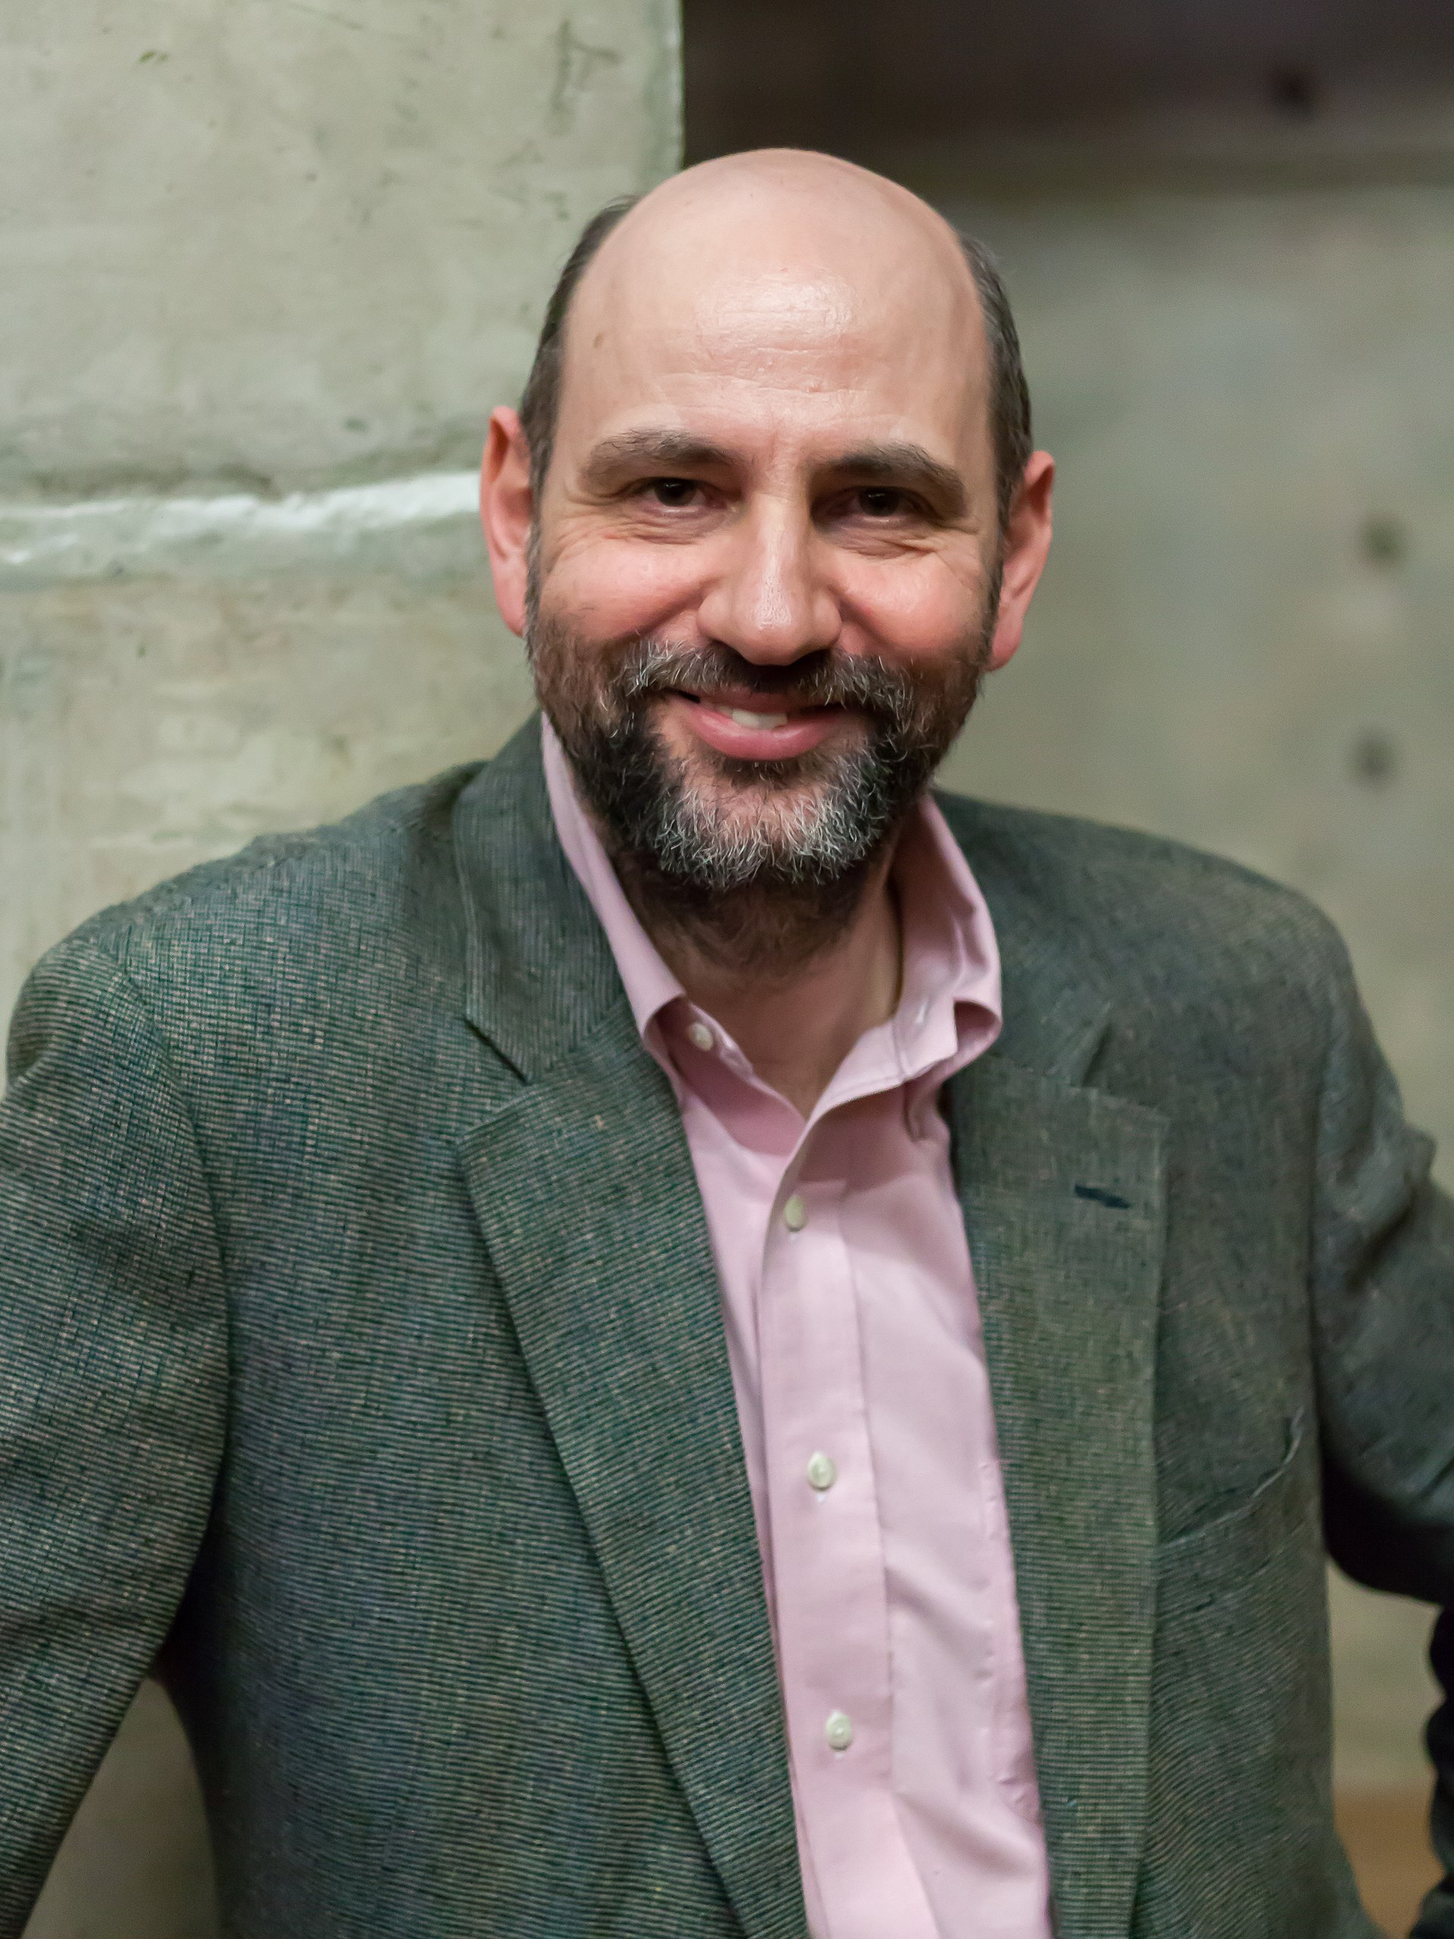
Problem #1: Programs need to be read by people
“Any fool can write code that a computer can understand. Good programmers write code that humans can understand”
- Martin Fowler

Slide 9
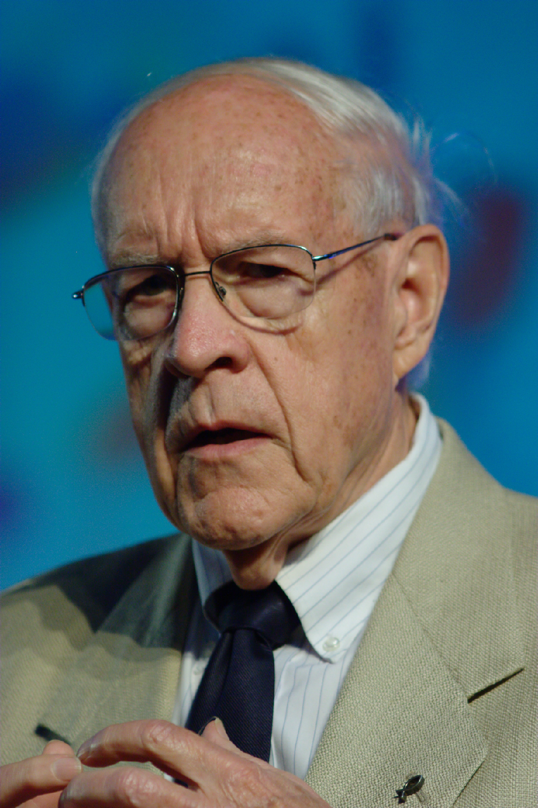
Problem #2: People need to talk to each other
“Adding manpower to a late software project makes it later”
Fred Brooks, 1975
Notes:
If you have n people on a project, you have O(n^2) potential connections between them.
In today’s world, we'd say something like "personnel“ hours rather than "man"-power.

Slide 10



So, software engineering must encompass:
People,
PROCESSES,
& Programs

Slide 11
The course will cover
People
how to organize software teams and make them function effectively
how software engineering teams work in larger organizations
Processes
how to divide a large project into engineering tasks
how to coordinate the tasks to form a coherent whole
Programs
how to write programs that people can understand and maintain
…focusing on a particular domain (medium-sized web applications)

Slide 12
Think of {your software’s} design at three scales
The Planning Scale
key questions: How do we make software artifacts “good”? What does that mean? Who decides?
The Organizational Scale
key questions: What are people’s needs? How do we design software artifacts that meets those needs?
The Implementation Scale
key question: how to design software artifacts that are easy to test, understand, and modify?

Slide 13



So, software engineering must encompass:
PLANNING,
ORGANIZING,
& IMPLEMENTING

Slide 14
So, software engineering must encompass:
PEOPLE
PROCESSES
PROGRAMS
mostly
out
of
scope
PLANNING
ORGANIZING
This class is here-ish
implementing
previous
classes
(OOD)
Notes:
These two dimensions make a grid, and you can think of much of the content of this class in terms of this grid of concepts
This class talks about implementing software, but mostly assumes you already have the foundation you need to design programs at the implementation level. The class also talks about larger scale planning and design issues — when we can build anything, how do we decide what to build? — but there’s a lifetime of information to learn here.
The class is focused around the middle — how people, processes, and programs are organized at the scale of weeks and months to do software engineering: to design, construct, and maintain large programs over time.

Slide 15
Learning Objectives for this course:
By the end of this course, you will…
…be able to define and describe the phases of the software engineering lifecycle.
…be able to explain the role of key processes and technologies in modern software development.
…demonstrate the ability to use these key processes
…demonstrate the application of key technologies and major tools used in elementary software engineering tasks.
…design and implement a portfolio-worthy software engineering project in a small team environment that can be showcased to recruiters.
These are normal learning goals for a course at a university!
This is maybe a little different

Slide 16
The course will be delivered through:
Lectures and in-class discussion
In person (most sections) or via zoom (only for online section)
Slides will be available on course website
Practice activities
these will give you practice with the technologies we will use
we will often start these during class, sometimes in groups
these will be graded
Tutorials
these will give you background on key processes and technologies {we will use} at a greater level of detail than we can cover in class
Primary “reading” for the course in lieu of a textbook

Slide 17
Course Mechanics: Lectures and Attendance
Classes will include both lectures and in-class activities.
Be sure to bring your laptop
Each instructor will use individual approach to grade the in-class activities.
Attendance is expected for both on-the-ground and remote sections (especially when working on activities, “work on project” sessions and demos)
For excused absence, please contact the instructor by email.

Slide 18
Course Deliverables
First, an individual project, which we will assign. This is to be done individually.
divided into 3 deliverable projects
this counts for 30% of course grade
Then a group project, done in teams of about 4 people
this counts for 40% of course grade
There will be an exam (worth 20%) on March 11 - 13 during Week 10). There will not be a final exam. Check Calendars
Participation / Completion of activities (10%)
Notes:
* Exam is on the first lecture after spring break

Slide 19
Course Requirements
To pass, you must also:
Do most of the individual projects
Demonstrate understanding of concepts in midterm
Demonstrate ability to do software development & engineering in group project
Present your final project
Notes:
More details on the course website

Slide 20
Technology
We will use:
TypeScript as implementation language
Vitest as Testing Framework
Visual Studio Code as our IDE
React for webapps
GitHub Projects for Project Management
GitHub Actions / Render for CI/CD
Also, other miscellaneous tools

Slide 21

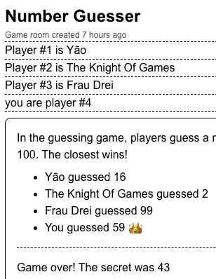
Welcome to the Game Nite team!
We want to be the #1 spot for people who want the social experience of watching Twitch™ but for turn-based games
CS 4530 is part traditional academic course, part “having a new software job” simulation
The individual projects are like “onboarding” projects, and the group project is a scaled-down version of actual product delivery
Course staff have a secondary role as part of this simulation
Notes:
(Quick demo)

Slide 22
Welcome to the Game Nite team!
The individual projects will help you become familiar with the codebase (worth 30% of course grade).
The team project (worth 40%) will be a new feature that you will propose.
Instructors will form the teams with your input.
Further breakdown of team project grade is:
Planning (worth 8% of course grade)
Process (worth 8%)
Product (worth 16%)
Reports (worth 8%)
Peer evaluations (surveys) may be utilized, and individual contributions WILL impact your project grade (between 0-100%).

Slide 23
Grade Appeal Policy
If you have concerns regarding the grading of your work, please let us know right away.
We provide mechanism for you to request regrades for all work submitted (usually Gradescope appeals)
Do not post on Piazza or email your TA or instructor
All regrade requests must be submitted within 7 days from your receipt of the graded work.
If your regrade request is closed and you feel that the response was not satisfactory, you may appeal to the instructor via email within 48 hours

Slide 24
Late Policy
Individual projects & activities are late if it is not turned in by the deadline.
10% will be deducted for late individual work turned in within 24 hours after the due date
Individual work submitted more than 24 hours late will receive a zero.
If you're worried about being busy around the time of a HW submission, please plan ahead and get started early.
If you have an accommodation from Disability Access Services (previously DRC), you must request it from the instructors separately for each assignment or exam.
No late submissions allowed for any group project submissions
DAS Accommodations are usually NOT available for Group Assignments (please work with instructor, we’ll make something work!)

Slide 25
Academic Integrity (1)
Students must work individually on all homework assignments.
We encourage you to have high-level discussions with other students in the class about the assignments, however, we require that when you turn in an assignment, it is only your work. Copying any part of another student's assignment is strictly prohibited.
Small snippets of publicly posted code are allowed with attribution
If you steal someone else's work, you fail the class.
You are responsible for protecting your work. If someone uses your work, with or without your permission, you fail the class.

Slide 26
Academic Integrity (2)
If you are concerned that by reusing and attributing that copied code it may appear that you didn't complete the assignment yourself, then please raise a discussion with the instructor.
If you are in doubt whether using others' work is allowed, you should assume that it is NOT allowed unless the instructors confirm otherwise.

Slide 27
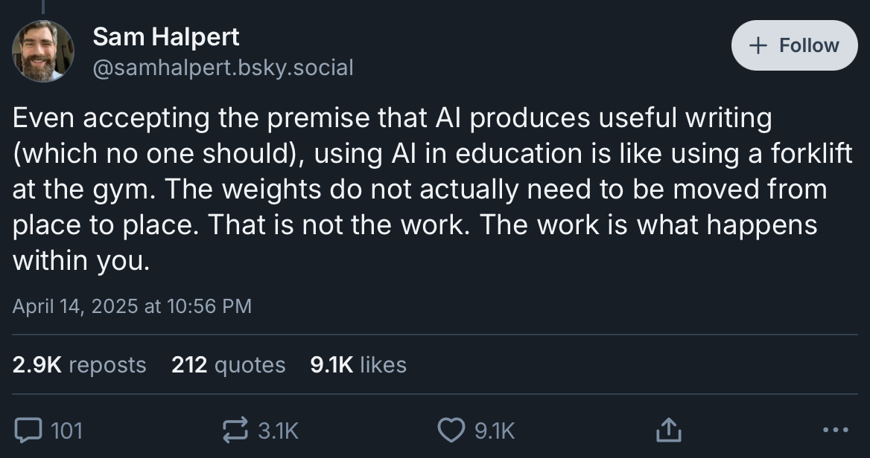
Academic Integrity & LLM-based Tools
IP1 & IP2 are designed for you to do without LLM-based tools.
No Copilot fancy auto-complete
No natural language to code tools
No chatbot-assisted code understanding
https://bsky.app/profile/samhalpert.bsky.social/post/3lmt3coqvqk2w
Notes:
<see a detailed version of this policy on course website>

Slide 28
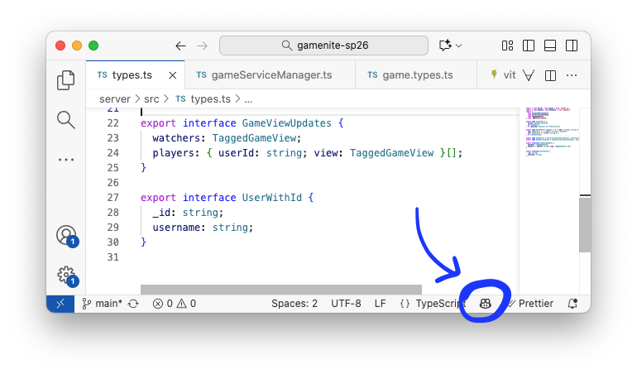
Using LLM-based Tools in This Class (1)
IP1 & IP2 are designed for you to do without LLM-based tools.
No Copilot fancy auto-complete
No natural language to code tools
No chatbot-assisted code understanding
Why? Because there are sophisticated TypeScript-powered tools for navigating codebases in VS Code (which don’t require a subscription). We want you to also have experience with these tools.
This is the button that turns Copilot off
Notes:
<see a detailed version of this policy on course website>

Slide 29
Using LLM-based Tools in This Class (2)
For IP3, exploration of generative tools is gently encouraged
For final projects
Use of AI tools is permitted — create a group policy on AI
You are responsible for your code and must understand it
You must document uses of LLM-based tools
We reserve the right to interview you to gauge your understanding (with possible grade adjustments)
Notes:
<see a detailed version of this policy on course website>

Slide 30
No LLM Tools For Writing
When we ask you to write English text, it’s because we want you to write it and because we’re going to read it.
You’re just disrespecting yourself and us by having us read LLM-generated text.
Notes:
<see a detailed version of this policy on course website>

Slide 31
Communication
Course web page (https://neu-se.github.io/CS4530-Spring-2026/)
Canvas will mirror the course web site.
Assignments, important notices, etc., will appear in both places.
Piazza (see Canvas for link)
Questions about content, policies, assignments, projects, etc. are better asked on Piazza, so everybody gets the same answers.
Contacting the Instructor
For private questions about your individual situation, please email the instructor directly (do NOT use Canvas messages – sometimes they do not get through to the instructors)
Please put CS4530 in the subject line so your message does not get overlooked
We encourage all students to “meet” with the instructor at least once!
Office Hours
Schedule is available at (https://neu-se.github.io/CS4530-Spring-2026/staff/)
TA Office Hours are held via Khoury Office Hours App

Slide 32
Review
Now that you've studied this lesson, you should be able to:
Explain in general terms what software engineering is
List your weekly obligations as a student
List the requirements for completing the course
Notes:
Lesson 1.1 Activity: Introductions Activity 1: Introduce yourself and ask students to introduce themselves
Activity 2 {Optional}: Welcome Survey. Then discuss survey responses and answer questions

